Slide 1
Object Persistence
Object Oriented Programming

Slide 2
One of the most critical task →save & restore data

Slide 3
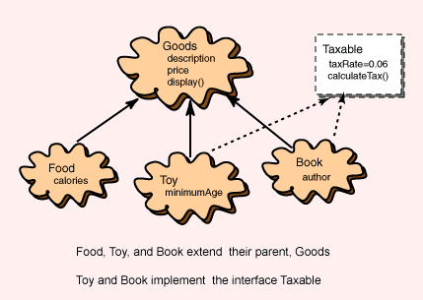
Simpanlah sejumlah objek buku ke dalam file

Slide 4

Objek Book:
Atribut
Author = JK Rowling
Description = Harry Potter
Price = 58000

Slide 5
Book.txt ??
Description = sample-book_description
Author = sample-author
Price = 24.95

Slide 6
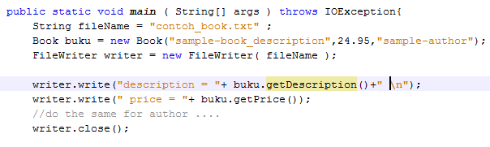
Is it the right code ?

Slide 7
Reader
Harus dibuat aturan saat parsing :
baris pertama berisi description
Baris kedua berisi price
dst
Ribet ☹

Slide 8
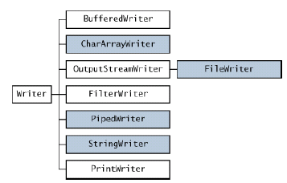

Slide 9
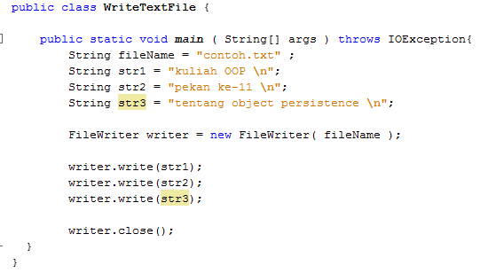
Try this and open the file !
Kok ada error ya??

Slide 10
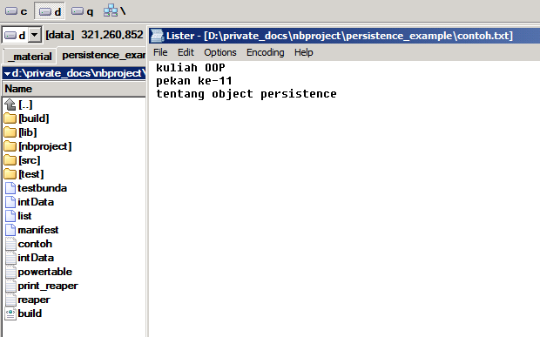
Isi file contoh.txt
file contoh.txt

Slide 11
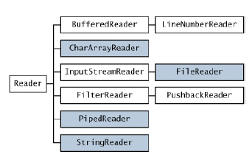

Slide 12
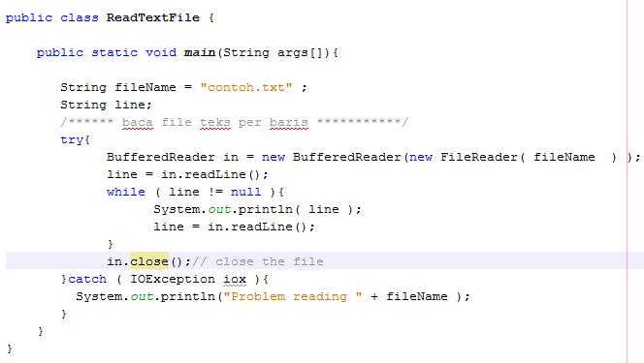
Try this !

Slide 13
Saving object ??

Slide 14
Object Serialization
takes an object's state, and converts it to a stream of data
Then it can be saved dan restored
persistent
without writing custom code to save object member variables
The object can be restored at a later time, and even a later location; have it maintain its state

Slide 15
Object Persistence
→storing the data, the behavior, and the relationships with other objects for later reuse to output valuable information.
- File
- DBMS

Slide 16
Object Persistence
serializing objects out to the disk and retrieving them later.
Serializing an object usually means to store the values of public properties of an object.
De-serializing would be just the opposite and retrieve the values and reconstruct the original object back to its original state.

Slide 17
interface Serializable
public interface Serializable {
}
Duh… interface itu apa ya? Lupa euy ☹

Slide 18
Any object whose class implements the java.io.Serializable interface can be made persistent with only a few lines of code.
No extra methods need to be added to implement the interface, however - the purpose of the interface is to identify at run-time which classes can be safely serialized, and which cannot.
public class UserData implements java.io.Serializable
Now, once a class is serializable, we can write the object to any OutputStream, such as to disk or a socket connection. To achieve this, we must first create an instance of java.io.ObjectOutputStream, and pass the constructor an existing OutputStream instance.

Slide 19
Some uses of serialization
To persist data for future use.
To send data to a remote computer using such client/server Java technologies as RMI or socket programming.
To "flatten" an object into array of bytes in memory.
To exchange data between applets and servlets.
To store user session in Web applications.
To activate/passivate enterprise java beans.
To send objects between the servers in a cluster.

Slide 20
Ingin disimpan sebuah buku dengan properti sbb:
Author : sample-author
Price : 24.95
Description : sample-book_description

Slide 21
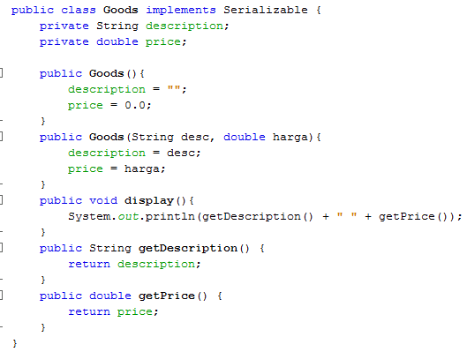
Superclass juga harus di-serialize lho !
Kode kelas Goods

Slide 22
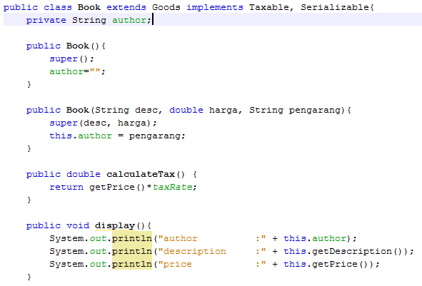
Kode kelas Book

Slide 23
Serializing ….
// Write to disk with FileOutputStream
FileOutputStream f_out = new
FileOutputStream("myobject.data");
// Write object with ObjectOutputStream
ObjectOutputStream obj_out = new
ObjectOutputStream (f_out);
// Write object out to disk
obj_out.writeObject ( myObject );

Slide 24
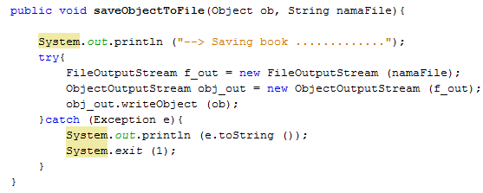
Highlight FileOutputStream
Kode diletakkan dalam method supaya mudah aksesnya

Slide 25
De-serializing….
// Read from disk using FileInputStream
FileInputStream f_in = new
FileInputStream("myobject.data");
// Read object using ObjectInputStream
ObjectInputStream obj_in =
new ObjectInputStream (f_in);
// Read an object
Object obj = obj_in.readObject();
if (obj instanceof Vector){
// Cast object to a Vector
Vector vec = (Vector) obj;
// Do something with vector....
}

Slide 26
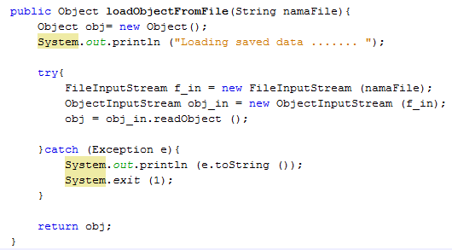
Highlight FileInputStream

Slide 27
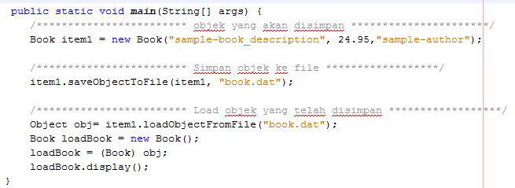
Highlight main

Slide 28
any Java object that implements the serializable interface can be written to an output stream this way.
Furthermore, any objects that are referenced by a serialized object will also be stored. This means that arrays, vectors, lists, and collections of objects can be saved in the same fashion - without the need to manually save each one.
This can lead to significant time and code savings.

Slide 29
A data stream containing serialized objects may contain a mixture of different object classes, so you need to explicitly cast an object to a particular class.

Slide 30
Saving password ? ☹
public class UserSession implements
java.io.Serializable
{
String username;
transient String password;
}

Slide 31
Benefit
Reducing time taken to write code for save and restoration of object or application state
Eliminating complexity of save and restore operations, and avoiding the need for creating a new file format
Making it easier for objects to travel over a network connection.

Slide 32
Exercise
Bagaimana jika yang ingin disimpan data sejumlah buku? ☺
Buat implementasinya !
Berkelompok: 2 orang

Slide 33
Steps
Kelas Book harus di-serialize
Implements Serializable
Kelas Goods (superclass dari Book) juga harus di-serialize
How to Serialize
Lihat ke slide – serializing –
How to De-serialize
Lihat ke slide – de-serializing –

Slide 34
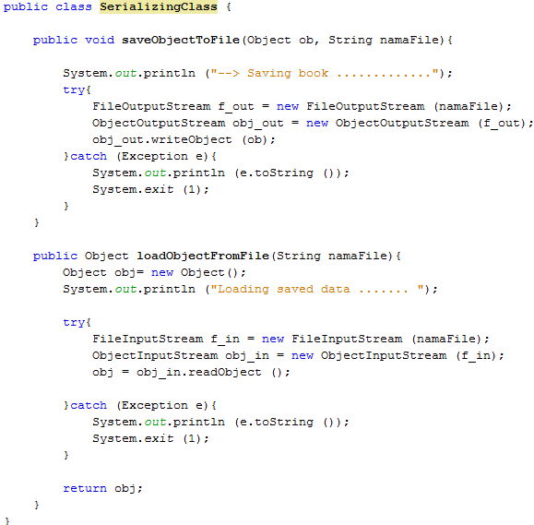

Slide 35
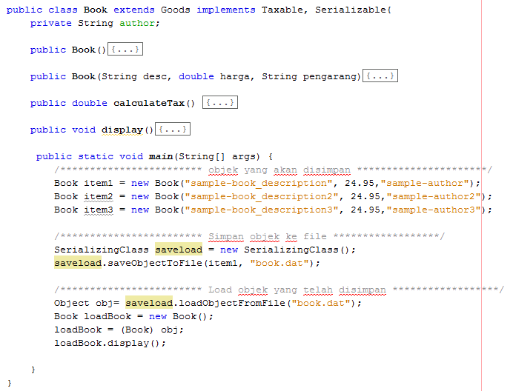

Slide 36
Bagaimana jika yang ingin disimpan adalah data sejumlah buku (atau sejumlah objek lain) ? ☺

Slide 37
Collection
Lihat selengkapnya di package java.util
Atau
Java Collection Frameworks
Array, List, Vector, dsb

Slide 38
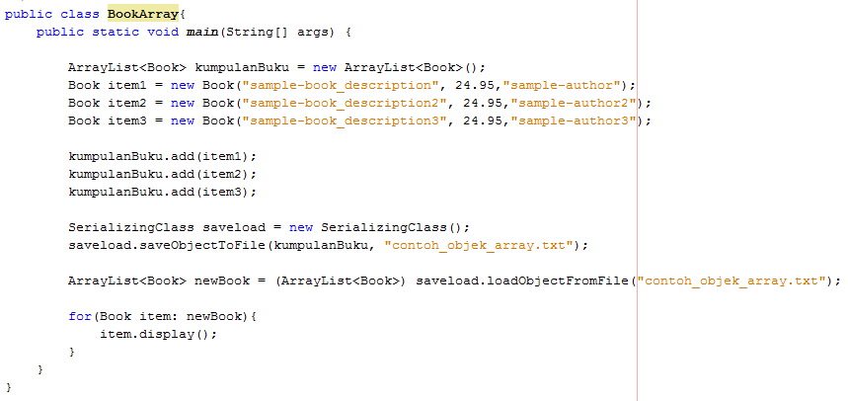
implements Serializable ??
Tambah elemen ke ArrayList
Salah satu cara traversal

Slide 39
Bagaimana jika hanya beberapa nilai atribut saja yang ingin disimpan saat membuat object persistence ?
Contoh kelas Book:
Simpan: nilai dari atribut author & description

Slide 40
Interface Externalizable
public interface Externalizable extends Serializable{
void writeExternal(ObjectOutput out) throws IOException;
void readExternal(ObjectInput in) throws IOException , ClassNotFoundException ;
}
2 method ini harus diimplementasikan di TIAP KELAS yang meng-implement interface ini

Slide 41
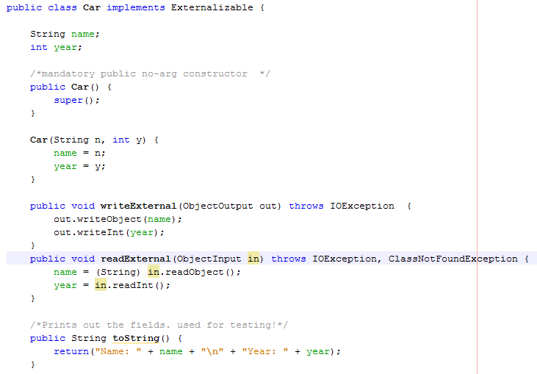
Mandatory constructor & method

Slide 42
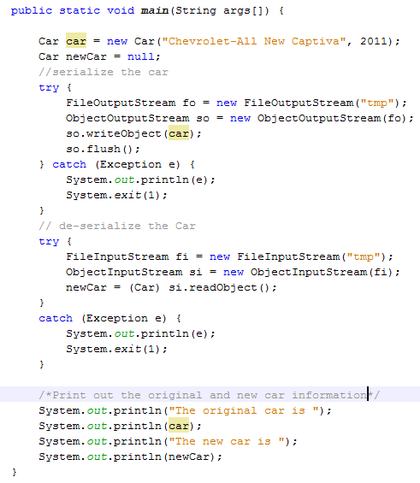
Cara save & load tidak berbeda jika menggunakan Serializable

Slide 43
Exercises
Buat kelas Book baru (atau kelas lain yg Anda sudah punya) yang mengimplementasikan interface Externalizable
Implementasikan 3 tipe koleksi berikut untuk menampung sejumlah objek dari kelas yang Anda buat:
ArrayList
Vector
Bebas (Hashtable, HashMap, etc)

